Slide 1
Conclusions
Matthias Zwicker
University of Bern
Notes:
Thanks for the introduction.
(I’ll be presenting today some work I did during my PhD at the University of Bern under the supervision of Matthias Zwicker.)

Slide 2
Properties of effective filters
Exploit auxiliary information from renderer
  Per-pixel features (normal, position, albedo, etc.)
Support complex filter shapes
  Joint bilateral, NL-means filter
  Weighted local regression
Use per-pixel filter parameters
  Use input variance
  Predict using mutual information, learning
  Estimate error of filter output (SURE, bias and variance)

Slide 3
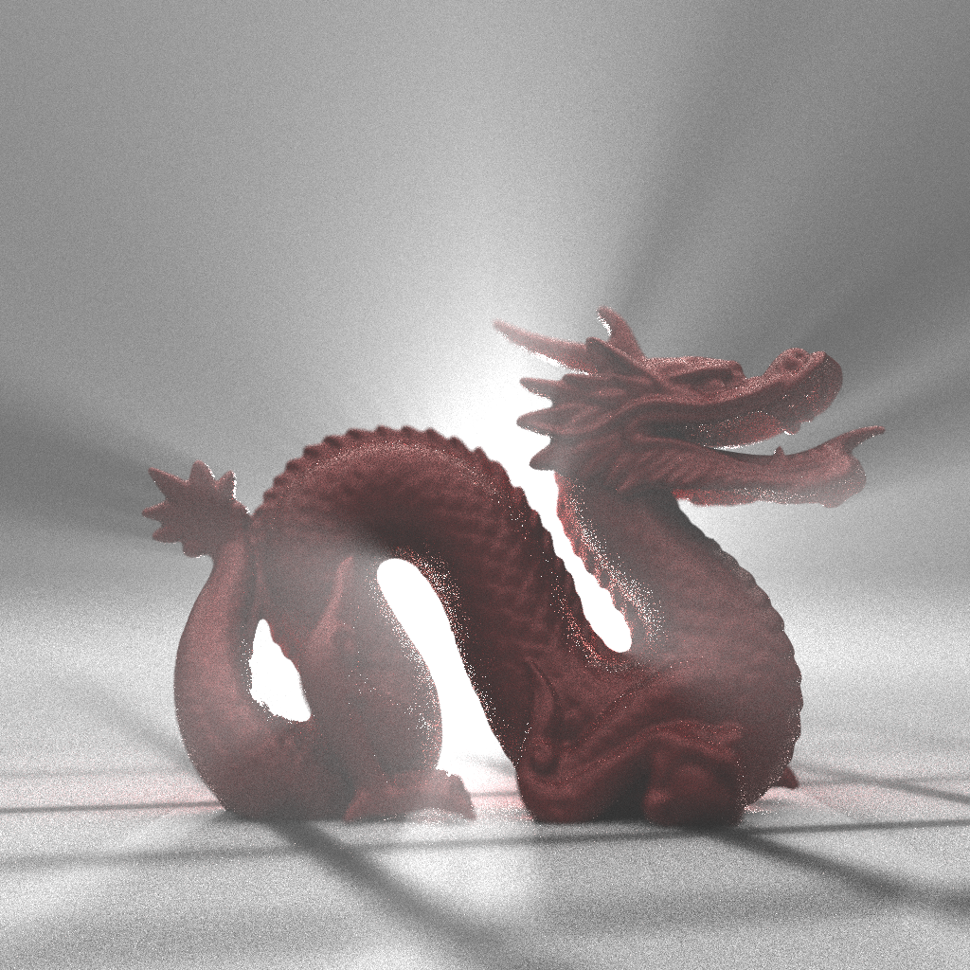

Industry adoption
Pixar RenderMan
Disney Hyperion
innoBright
www.innobright.com

Slide 4
Open challenges
Real-time applications
Animation sequences
Beyond image space filtering
  Exploit additional path space properties
Leverage theoretical foundations
  Sampling theory
  Learning-based techniques
  Sparse methods
Theoretical analysis, proof of lower bounds on sampling density

Slide 5
Resources
Survey paper
  ”Recent advances in adaptive sampling and reconstruction for Monte Carlo rendering”, Computer Graphics Forum, 2015
Source code, partial list
  Rousselle et al. [RKZ11]: http://www.cgg.unibe.ch/downloads/asr-auxiliary.zip/at_download/file
  Rousselle et al. [RKZ12]: http://www.cgg.unibe.ch/downloads/nlm-code-data.zip/at_download/file
  Sen and Darabi [SD12]: http://dx.doi.org/10. 7919/F4MW2F28
  Kalantari and Sen [KS13]: http://www.ece.ucsb.edu/~psen/PaperPages/RemovingMCNoiseStuff/RemovingMCNoise_ v1.0.zip
  Moon et al. [MJL∗ 13]: http://sglab.kaist.ac.kr/VFL/
  Rousselle et al. [RMZ13]: http://www.cgg.unibe.ch/downloads/pg2013_code_data.zip/at_download/file
  Moon et al. [MCY14]: http://sglab.kaist.ac.kr/WLR/

Slide 6
Thank you!
Funding agencies and partners
  NSF, Intel, Nvidia, SNSF, NRF
Co-authors
Course organizers and presenters:
Nima Kalantari
UC Santa Barbara
Fabrice Rousselle
Disney Research
Matthias Zwicker
University of Bern
Pradeep Sen
UC Santa Barbara
Sung-Eui Yoon
KAIST

